Slide 1


ML Intermediate Project
Gender Recognition by Voice and Speech Analysis

Slide 2

This database was created to identify a voice as male or female, based upon acoustic properties of the voice and speech. The dataset consists of 3,168 recorded voice samples, collected from male and female speakers. The voice samples are pre-processed by acoustic analysis in R using the seewave and tuneR packages, with an analyzed frequency range of 0hz-280hz (human vocal range).

Slide 3

The goal is to build a model to predict gender by speech analysis.

Slide 4
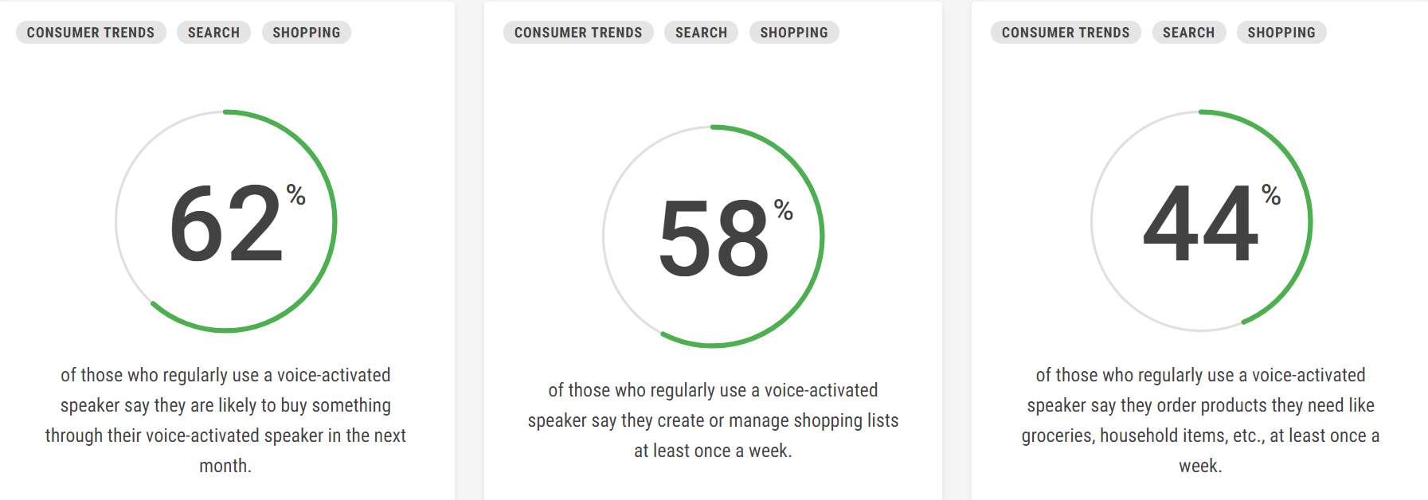
Speech recognition has various applications including human to machine interaction, sorting of telephone calls by gender categorization, video categorization with tagging and so on.

Slide 5
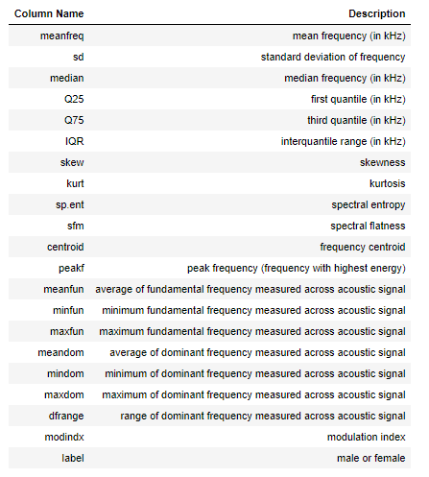

Slide 6
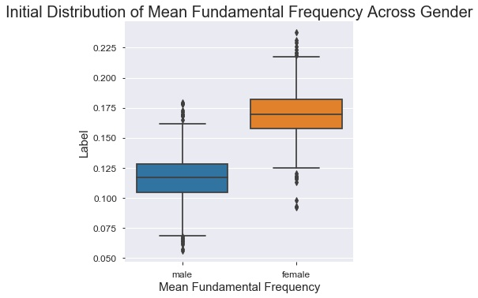
The voiced speech of a typical adult male will have a fundamental frequency from 85 to 180 Hz, and that of a typical adult female from 165 to 255 Hz.
Source: Wikipedia

Slide 7
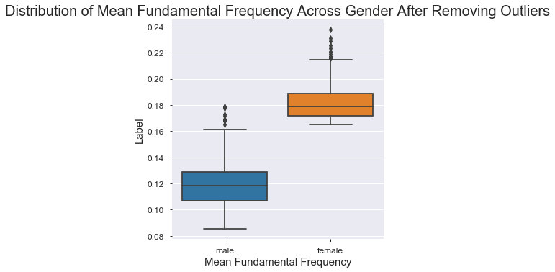
Number of rows removed = 710

Slide 8
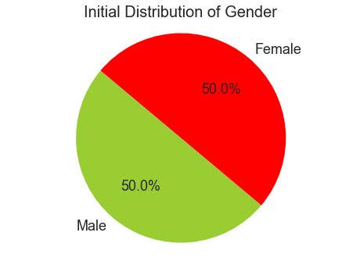
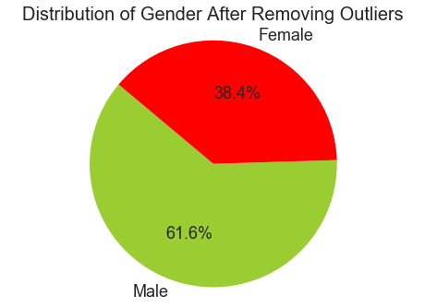

Slide 9
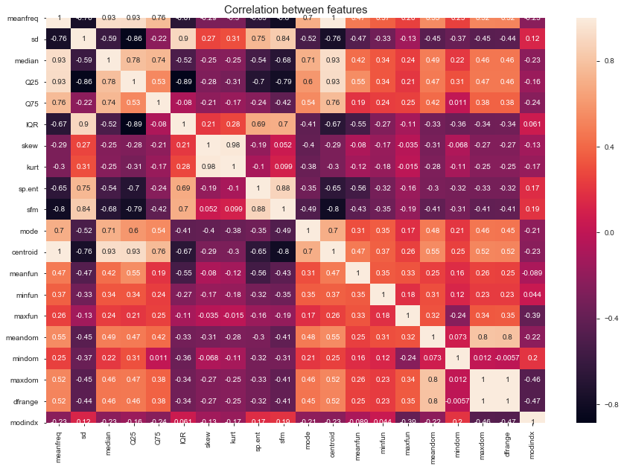

Slide 10
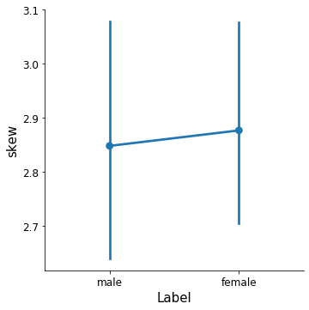
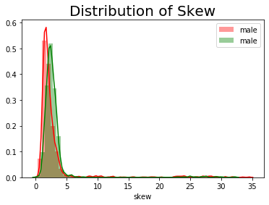
I digged deep into all the features using the point plot and observed that there is not much variation across gender in the skew column.

Slide 11
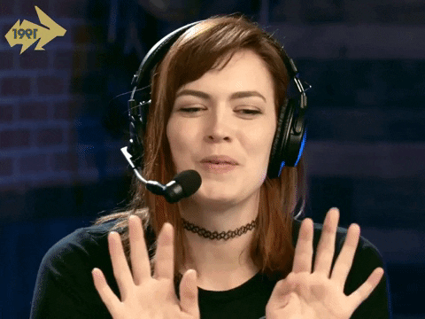

Slide 12
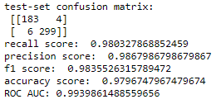
Gaussian Naive Bayes
RECALL
PRECISION
F1 SCORE
ACCURACY SCORE
AUC-ROC

Slide 13
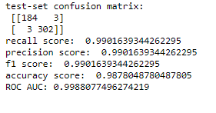
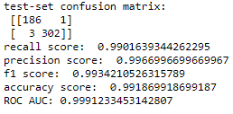
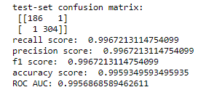
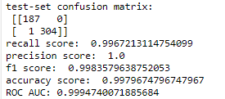
Logistic Regression
K-nearest Neighbours
Decision Trees
Random Forest

Slide 14
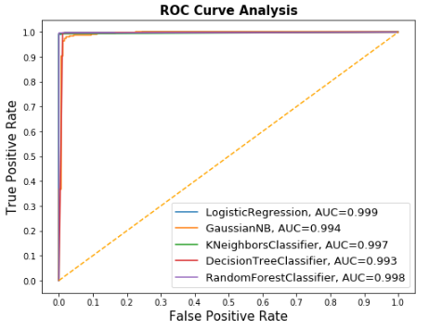

Slide 15
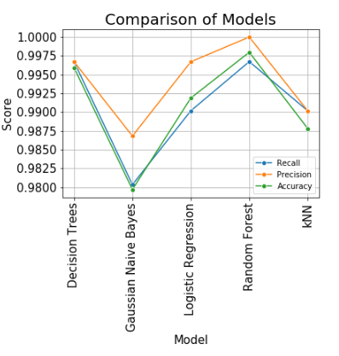


Slide 16


Slide 17
Thank You!

